Slide 1
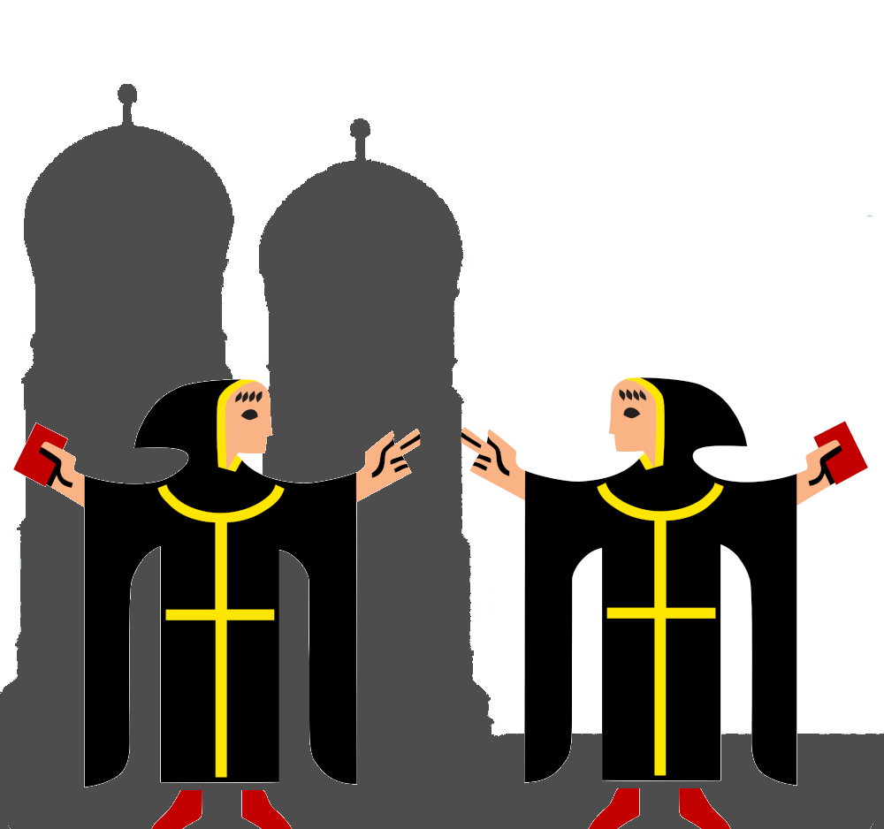
IsarMates
Curing lonelyness in munich by bringing people together for activities
Notes:
1. Table of contents
2. Introduction
3. Our company
4. Our team
5. Problem
6. Them vs. us
7. Solution
8. SWOT analysis
9. Product overview
10. Our plans
11. Product demo
12. Traction
13. Case study
14. Reviews
15. Awards
16. Market size
17. Target
18. Competitors
19. Business model
20. Timing
21. Predicted growth
22. Investment

Slide 2
01
Motivation
Why are we even doing this?

Slide 3
Project Motivation
1) Cure loneliness in Munich & meet new people
2) Rewards to participating citizens
- e.g. Discounts at participating companys
3) Generate customers for participating companies
4) Introduce blockchain ecosystem to the common man
- Implies easy interface
5) Make our city more digital

Slide 4
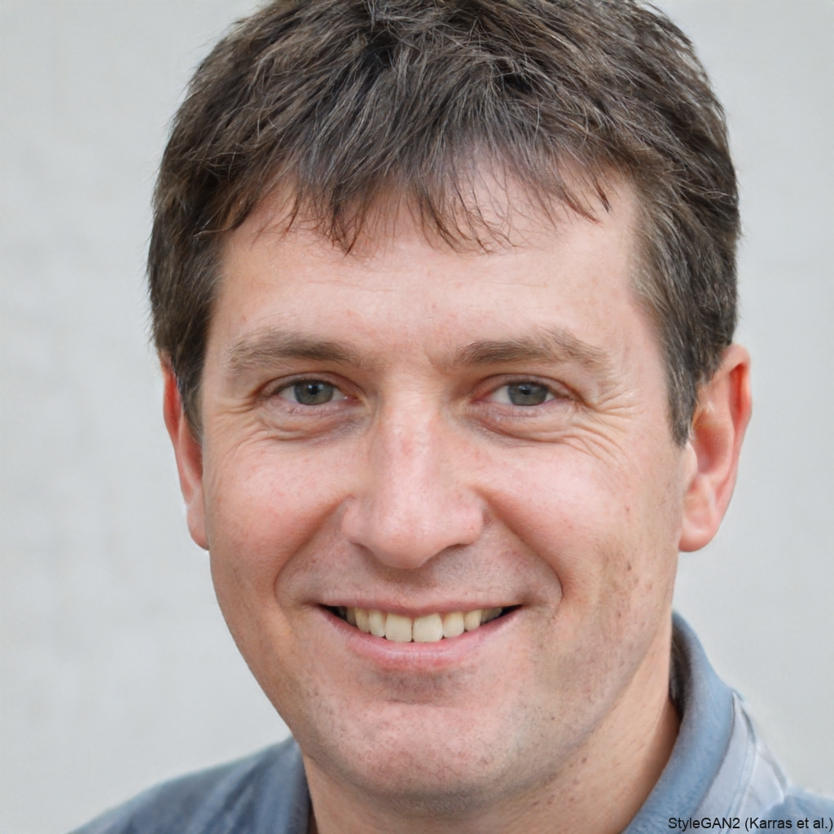
Max Mustermann
- Is new in Munich
- Has no friends here yet
- In search for cool people & places

Slide 5
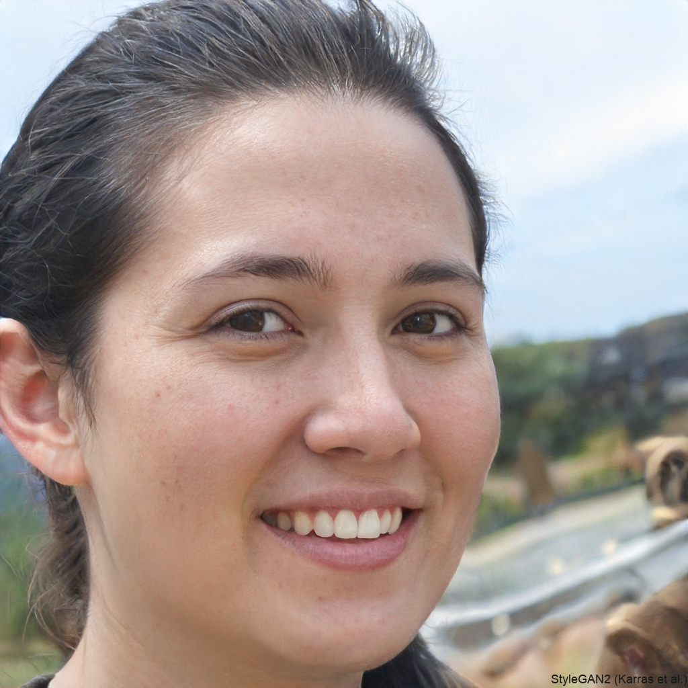
Anna Smith
- Has a Bowling Alley in Munich
- Usually few guests on Tuesday

Slide 6
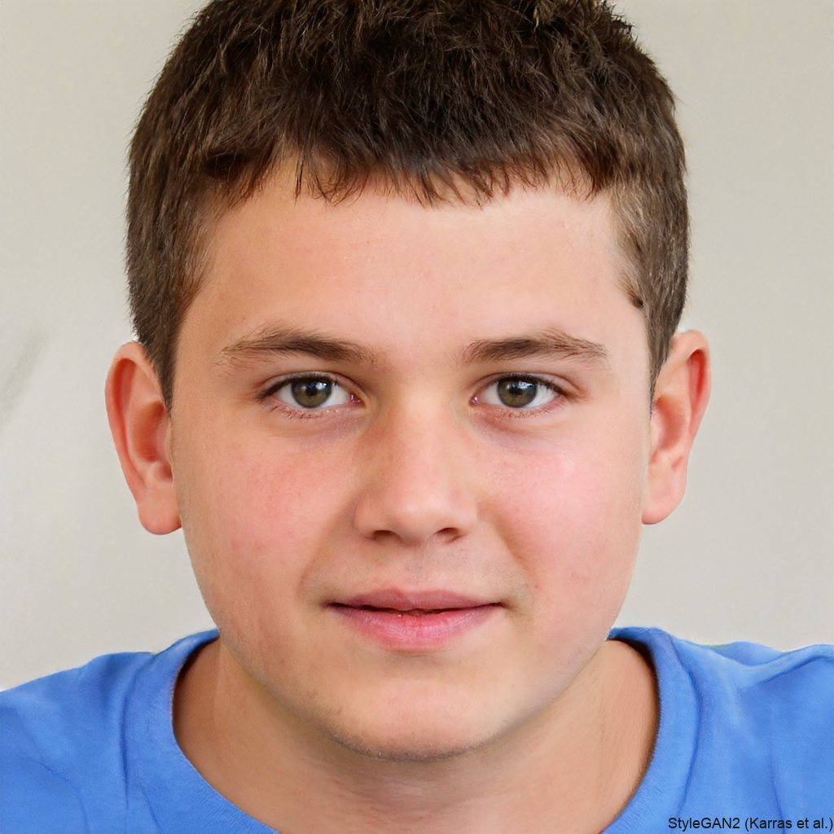
Kevin Pascal
- Really enjoys Bowling
- Is looking for cheaper entry or new people to play with/against

Slide 7
02
Concept
Did we really think this all through?

Slide 8
Concept
Max Mustermann
Anna Smith
Gets to know Kevin & the bowling alley
Earns more on formerly quiet days
Kevin Pascal
Gets to play with Max

Slide 9
“But wait – there´s more”
01
02
Kevin & Max collect XP for participating at Events
They can mint different grades of NFTs monthly - depending on their event participation rate
Kevin & Max get discounts at all participating companys corresponding to their NFT grade

Slide 10
03
Live-Demo
🎶 Live is live 🎶

Slide 11
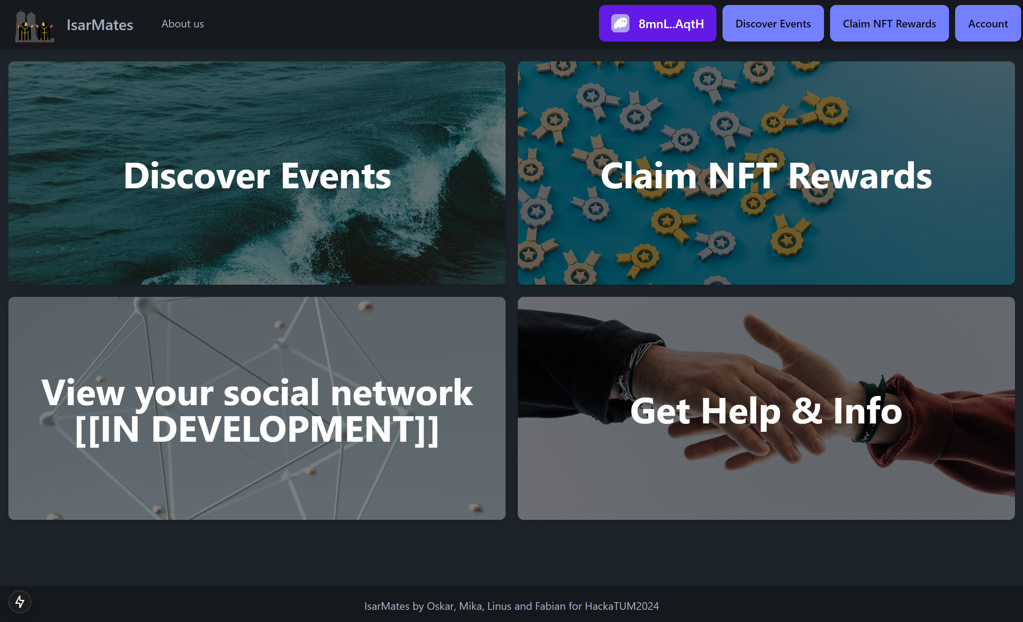
Live Demo

Slide 12
04
Relevance of SOL
Do we only use Crypto, for the Hype?

Slide 13
Why is Solana/Blockchain ideal?
1) SOL provides fast & cheap transactions
2) SOL is scalable and available for all
3) BC is decentralized
=> offers Trust, Validity and Secure Ownership
4) BC allows for NFTs
=> Digital Certificates, Gamification

Slide 14
05
Outlook
Wait, we didn’t implement everything within 36h??? Cringe…

Slide 15
Our Plans
Soon
User to User Events & Volunteering Points
Way in the future
Chat Feature whilst mining
Penalty for not showing
Later
NFT after every Event
& Collections for Special events
Maybe never

Slide 16
Thank you!
Do you have any questions?
“This kind of app has the potential to revolutionize local social interaction, making it more meaningful, secure, and rewarding. By combining Web3 principles with community engagement, it could create vibrant, self-sustaining ecosystems that encourage real-world connections while empowering users with ownership and utility.
Fabian Löffler
Oskar Weinfurtner
Mika Mauser
Linus Wiggering
—ChatGPT

